Slide 1
TOPIC :PANDAS LIBRARY

Slide 2
NAME : RATHOD PARTH VIKASBHAI
ENROLLMENT NO:2302031000091
ROLL NO:39
DIVISION:4 IT B (B)
COURSE:B.TECH (IT)
SUBJECT NAME : PYTHON PROGRAMMING

Slide 3
What is pandas?
Pandas is open source.
BSD- licensed Python library providing high - Performance.
Easy to use for data structures and data analysis.
Pandas use for different types of data.
tabular data with heterogeneously-typed columns.
Ordered and unordered time series data.
Arbitrary matrix data with row & column labelso
Unlabeled data
Any other form of observational or statistical data sets

Slide 4
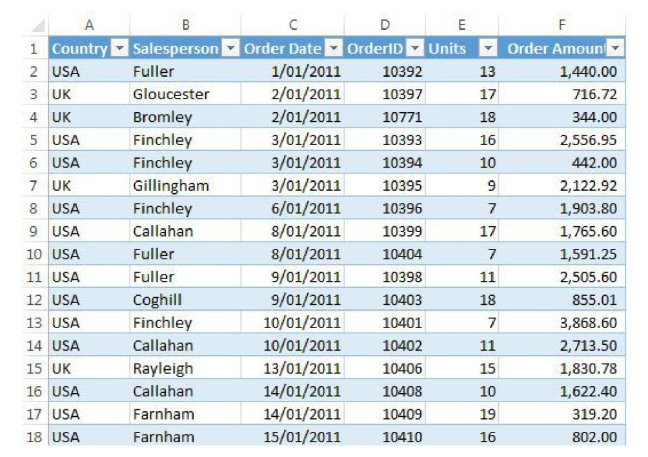
Pandas in data frame
max
std
Filter
min
count

Slide 5
Features of pandas
It has a DataFrame Object with customized indexing.
We can reshape data sets.
We can perform aggregations and Transformations on the data sets.
It is used for data alignment and integration of the missing data.
It provides the functionality of Time Series.
Process a variety of data sets in different formats like matrix data,tabular heterogeneous, time series.
Process a variety of data sets in different formats like matrix data,tabular heterogeneous, time series.

Slide 6
Usage of Pandas
Modeling
Visualization
High Performance Computing
Big Data
Statistical Computing
Numerical Computing
Text Processing
Computing Language
Educational Outreach

Slide 7

How to install pandas
You can run following command to install pandas.
Pip install pandas
Or
Conda install pandas
After installation you can check version of pandas by running the following command at python script mode.
Import pandas
pandas.__version__

Slide 8
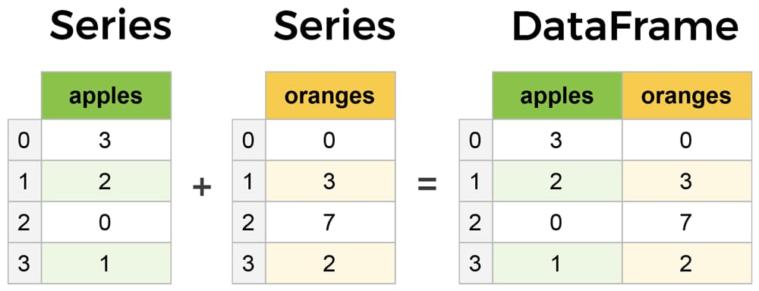
Data Structures
There are 2 data structures in pandas.
Series.(One D array)
Data Frame

Slide 9
Series Data Structure
Series is a one -dimensional array.
It contain homogeneous data.
Size is fixed.
10
20
30
40
50
60
70
80

Slide 10
Series Data Structure Cont.
Series is One Dimensional array to hold different types of values.
pandas.Series( data, index, dtype, copy)
data: It can be any list, dictionary, or scalar value.
index: The value of the index should be unique and hashable. It must be of the same length as data. If we do not pass any index, default np.arrange(n) will be used.
dtype: It refers to the data type of series.
copy: It is used for copying the data.

Slide 11
Creating a Series
We can create Series by using various inputs:
Array
Dictonary
Scalar value

Slide 12
Using Array
import pandas as pd
import numpy as np
info =
np.array (['R','a','y','s','T','e','c','h’])
a = pd.series(info)
print (a)

Slide 13
Using Dictionary and scalar Value
Using dictionary
import pandas as pd
info = {1:'rays',2:'tech’}
a = pd.series(info)
print(a)
Using Scalar Value
import pandas as pd
a = pd.Series(4,index=[1,2,3,4,5])print (a)

